Slide 1
INTERVIEWS

Slide 2
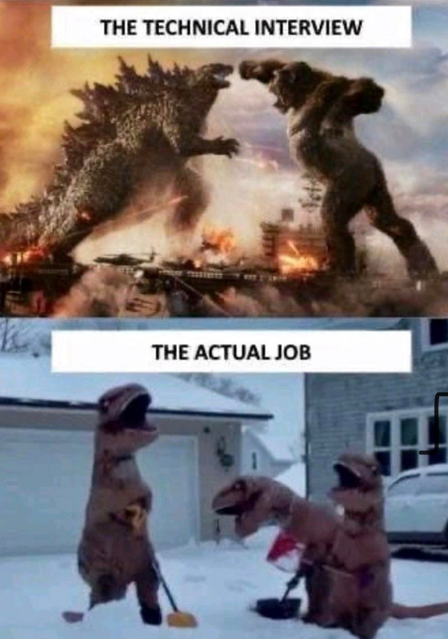
BACKGROUND
Interviewing in tech is a skill in itself. For some companies, it has nothing to do with your credentials, experience, or portfolio, it is a skill set in itself to master. Some companies will not move you to the next step unless you know something as trivial as SOLID principles.
There are some software jobs that are ridiculously easy yet their interviews are ridiculously hard.

Slide 3
HR VS ENGINEERING
Recruiting is divided between the engineering department and HR.
HR orchestrates the interviews, and they are on the candidates side, because their performance is based on the number of hires that are brought on a company. So it is ok to ask a recruiter questions about how to be successful on the technical interviews.
The engineering interview is going to have phone screens, coding, behavioral, system designs.

Slide 4
HIRING THE WRONG CANDIDATE
Companies can either hire a true negative, true positive, false negative, or false positive.
A true negative and true positive means they assumed the candidate correctly per their performance.
A false negative is a candidate they rejected but was actually a good candidate. Although this occurs from time to time, companies are aware that these misses will occur.
A false positive is a candidate that was accepted but was actually a bad candidate. These occasions are the most costly to companies.
It is assumed that someone who does well on an interview, will do well on the job, even though interview skills may have nothing to do with the job.

Slide 5
WHY FALSE POSITIVES ARE HIRED
Interviewers often ask easily acquirable questions and assume the candidate is good.
Easily acquirable questions are questions you can study for the day before and say nothing in depth about someone’s dev abilities.

Slide 6
TYPES OF COMPANIES

Slide 7

FAANG AKA MANGA AKA MAMAA
FAANG companies are known as the ivy league of tech companies. They pay the highest but also have the highest selectivity. In fact, it’s 20X harder to get into Google than it is to get into Harvard. Only 1 in 500 Google applicants get an offer.
FAANG companies include Facebook, Apple, Amazon, Netflix, Google.

Slide 8
FAANG DIFFERENCES
Google is known for work-life-balance.
Meta is known for more work but faster promotions.
Amazon is known for team dependency and high sign on $.

Slide 9
BIG-N
Big-N are similar to FAANG but accompase a wider range of high-end tech companies.
Example Big-N companies include Facebook, Google, Amazon, Apple, Netflix, Twitter, Square, Microsoft, Snap, Bloomberg, Yahoo, Yelp, Unicorns, Uber, Airbnb, Dropbox, and Palantir.

Slide 10
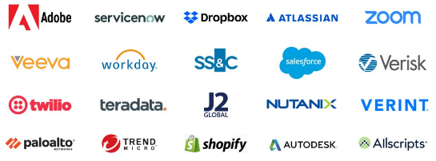
SAAS
A SaaS company is a company that hosts an application on the internet like a full-stack application for example, as opposed to a video game, or an operating system.
SaaS stands for Software As A Service.
Examples include Salesforce, Microsft, Adobe Creative Cloud, FreshBooks, Paychex, Google G Suite, Xero, Zendesk, Intuit, and Cisco.

Slide 11
THE PREP

Slide 12

CRACKING THE CODING INTERVIEW
Every developer should read Cracking the Coding Interview before interviewing with companies.
It was written by a software engineer who spent many years as an interviewee and interviewer in FAANG.
She describes the mindset of interviewers, and why they often reject candidates that you would otherwise think they were excellent.
She also describes how to best answer some of the most common questions on interviews.

Slide 13

GROKKING ALGORITHMS
Grokking algorithms is a secondary source that is also very helpful for algorithms on interviews.

Slide 14
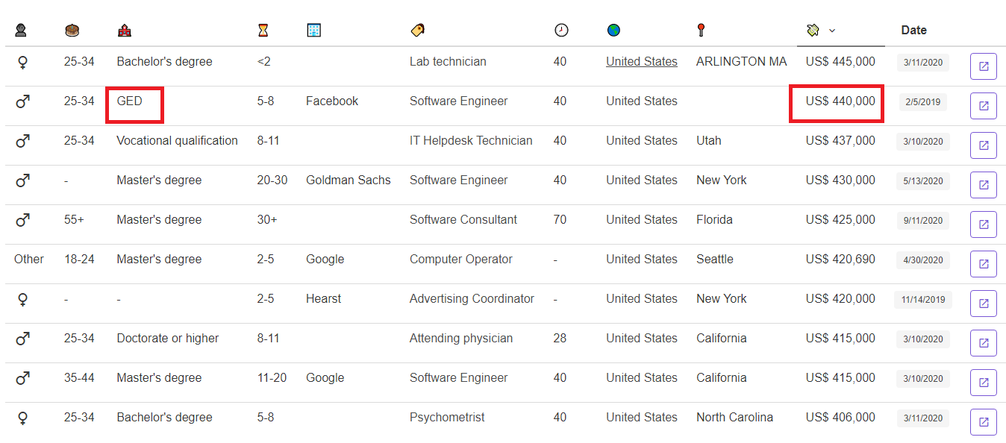
EDUCATION
Experience has more weight than a college degree but a college degree has more weight than a GED or associate’s degree.
Someone without a college degree would certainly make it in this industry but they would require experience or exceptional abilities.
A lot of devs envy the computer science degree even if they are employed. Many of them claim to not be treated the same in this industry.
A CS degree is probably the most valuable degree a college can offer if you apply to the right companies.

Slide 15
BEFORE APPLYING…
Before applying, make sure you have 2 out of 3 of the following elements mastered:
Experience
Education
Portfolio
If you don’t have at least 2 out of those 3 elements mastered, don’t even bother applying to jobs. You’ll waste your time and the recruiter’s time.

Slide 16
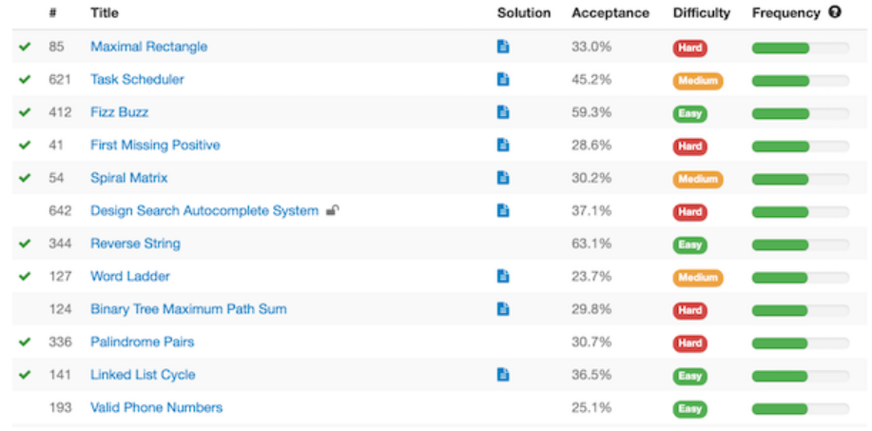
LEET CODING
Leetcode.com is an app where you can practice coding many different kinds of algorithms.
If you have never coded an algorithm before, this may be a good place to start.
Many software companies, especially the higher paying FAANG companies, almost always have an online assessment with 2-3 leet code type exercises.
These companies will not care if you are Steve Wozniak, you will get rejected if you do not pass their leet code exam.

Slide 17
LEET ADVICE
One strategy has been to not try to solve any leet codes at all, but instead study the solution and patterns in detail.
Some have been able to master FAANG interviews over and over again using this strategy.
When asked about how to make your algorithm more efficient, especially with traversals, it is very common to suggest using a key-value pair dictionary, so that an O(n) efficiency can turn into an O(1).
Talk through your thought process when doing a coding exercise. They are more interested in the process than they are about the solution.
When completing the code, don’t stop there, ask if there are some edge cases you didn’t consider. Talk about improving efficiency.

Slide 18
PUT YOURSELF IN THEIR SHOES…
If you were an interviewer, and came up with this really cool puzzle, which candidate would you choose?
Alex took 30 mins to solve it
Bella took 50 mins to solve it
Chris was never able to solve it
Dexter took 15 mins but needed a lot of help
Ellie took 10 mins to solve it
Fred took 35 mins to solve it
Candidates are evaluated based on how well they do against their peers, per the exact same conditions set by the interviewer.
In this scenario, Ellie would be selected from that pool, even if Ellie’s credentials are a fraction of someone else’s.
This method of selection is much more common in FAANG as opposed to every day software mom and pop shops.
In non-cs engineering interviews, this method is not used, candidates are mostly hired based on years of experience.

Slide 19
RESUME
Resume should be 1 page. If you can’t fit it in 1 page, prioritize your accomplishments to the most relevant ones. Failing to keep one page shows a failure in prioritizing, and portrays a pack-rat mentality. There are developers with 30 years experience who fit their resume in one page.
Recruiters care about experience(90%), education(8%), and projects(2%)(i.e. portfolio websites) with significantly different weights to each. Essentially, experience and education is all recruiters really look for, everything else is fluff, soap, or HVAC ambience.
GPA is unfortunately an extremely rare indicator for offer success. GPA is mainly good for college applications, scholarship applications, or unique specialized research positions.

Slide 20
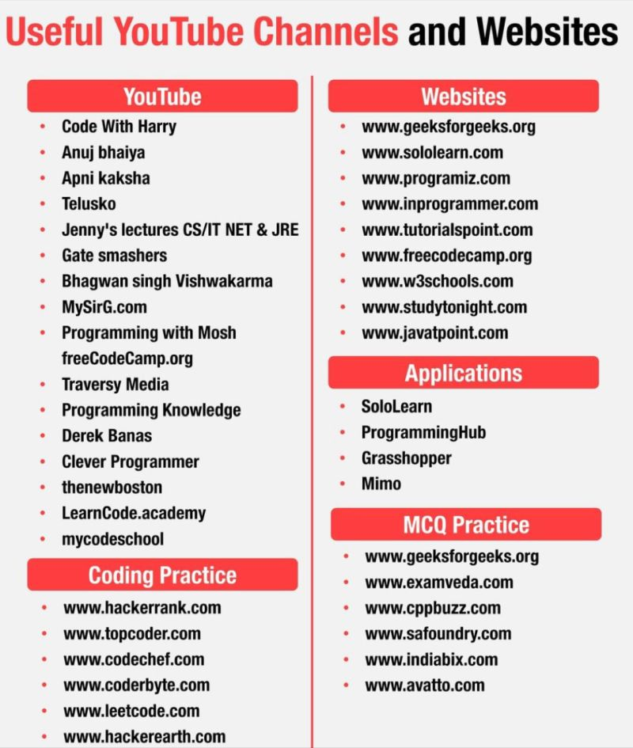
GOOD SITES

Slide 21
THE POSITION

Slide 22
POSITION RED FLAGS
Bread and butter
Shoot for companies where their bread and butter is software only, their culture is usually better.
Avoid companies that do software as a necessity, but their core business is something else like mfg.
Top security clearance requirements
Neighbors interviewed.
Ex-spouses interviewed.
Deep credit/police background check.
TWN required to be exposed i.e. past employment, even for lowest clearance i.e. public trust.
24/7 on-call
Must be ready to log in to a pc and dev within 15 mins.
Often covers a whole week.
No hangouts/No groceries.

Slide 23
POSITION RED FLAGS
Size of team
May be asked to support a complicated system by yourself if there are not a lot of SMEs.
Could be non-stop hot fixes instead of creative dev.
Could have unrealistic expectations.
Temporary contracts
No guarantee of renewals but can be lucrative if you are good at what you do.
Can sometimes be used to get a head start on popular techs and jump to full-time positions.
Kool-Aid
Larger companies will have a tendency to fire individuals who don’t fit in.
Like they say that people have a tendency to hammer the nails that stick out.
Kool-Aid can mean a company that maintains a high-school/fraternity mentality where culture and habits are not necessarily in the interest in improving the success of a company but more to give the company acceptance in how things are done.

Slide 24
INTERVIEW RED FLAGS
Boss is demanding as early as on the interview i.e. ‘why aren’t you wearing a tie’? Or forcing you to use a mac instead of a pc.
Interview questions that are super complex or theoretical and used to test elitism instead of engineering abilities. This is common in FAANG interviews.
Asking inappropriate questions like age, ethnicity, or religion.
It’s ok to walk out of an interview if either party display signs of red flags.

Slide 25
THE INTERVIEW

Slide 26
QUESTIONS THEY ASK YOU
Describe the SOLID principles?
Describe a few design patterns?
What is a JavaScript closure?
Describe how you would manage distributed computing?
What is the difference between null and undefined?
Why are you looking for a job?
What are you interested in?

Slide 27
SOLID PRINCIPLES
S-Single responsibility principle
a class should have one responsibility
O-Open closed principle
software entities should be open for extension but closed for modification
It means that it’s ok to modify instances but not templates
L-Liskov substitution principle
Use inheritance when you plan to use the methods of the super class as is, with minimal modifications.
I-Interface segregation principle
Use sub interfaces to accommodate more specialized groups of objects
D-Dependency inversion principle
Depend on abstractions instead of classes

Slide 28
QUESTIONS TO ASK THEM
How does your system scale?
How do you maintain security?
How many SMEs are on the team?

Slide 29
WILL POWER

Slide 30
REJECTIONS
Interviewing can be exhausting mentally i.e. time consuming, rejections, ghostings,…etc.
It’s very important to keep applying and not give up.
Don’t go in an interview looking for an offer, go with the mindset of learning 1 thing. If you learned 1 thing, you’ve succeeded at that interview.
Never get attached to a job until you get an offer and start date, because there will be tons of rejections when you are starting and it will hurt if you are too attached.

Slide 31
AVOID JUNIOR DEV HABITS
Jumping into an answer without properly asking for further clarifications.
Being confident about an answer that you didn’t really know and ended up getting it wrong. It’s better to say I don’t know than give a wrong answer. If you don’t know, it’s ok to give a best guess. Many interviewers will drop their recommendation from a single wrong answer.
Filling an answer with a lot of fluff as opposed to sticking to the point.
They give generalized answers instead of specific answers. They have breath but not depth.
Spaghetti coding i.e. coding any way possible to get the feature to work. This is not necessarily always a bad thing, but on certain applications that have to maintain a certain level of quality, this can be an issue.

Slide 32
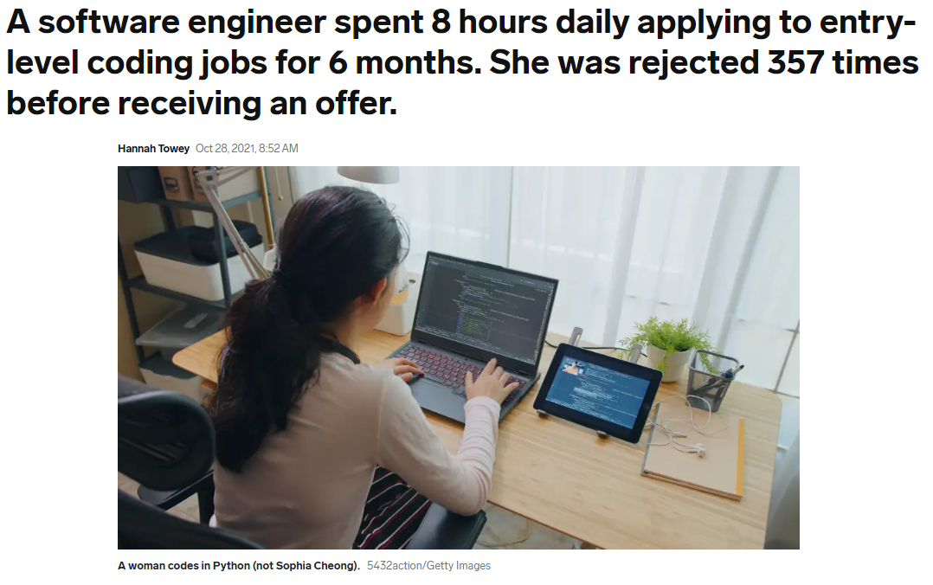

Slide 33
JUMPING SHIP

Slide 34
JUMPING SHIP
Jumping ship is one of the easiest ways to climb the corporate ladder and earn a pay boost.
Loyalty only benefits the employer, not the employee.
Since hiring budgets are often higher than retention budgets, new associates with less experience and less value to a company can often be paid more than associates who have several years with the company.
A typical annual merit increase is 1% - 3%, but jumping ship can go as high as 300%.
Although jumping ship will provide a pay boost, there is also a chance that the new job will not be an upgrade to your old job. It could be toxic, the boss could be incompetent, and the expectations could be unrealistic.
In some cases, you may end up losing your job after a few months, so it’s very important to jump ship with caution.

Slide 35
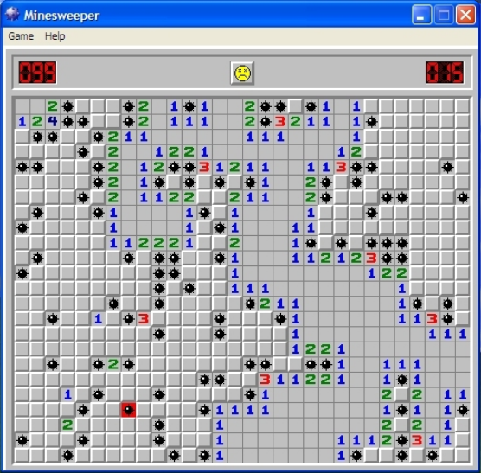
TECH JOBS ARE LIKE MINE FIELDS
Tech jobs are like mine fields.
Some are amazing, others are mines.
Learn to navigate the mines.

Slide 36
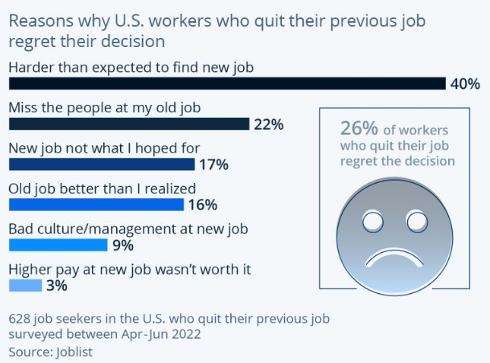

Slide 37
NEGOTIATING

Slide 38
CAN BE MORE SELECTIVE WITH EXPERIENCE
100% remote, no relocation
no startup environment
no hot fix/bug troubleshooting type work
no mouse monitoring
no bad leads
no bad stacks

Slide 39
NEGOTIATING
If an offer is made, make sure to negotiate for a good rate.
www.glassdoor.com, www.knowyourworth.site, www.levels.fyi, and https://www.bls.gov/ show how much software engineers will make based off experience.
The current rate is $50k/yr - $200k/yr, with an average of around $120k/yr.

Slide 40
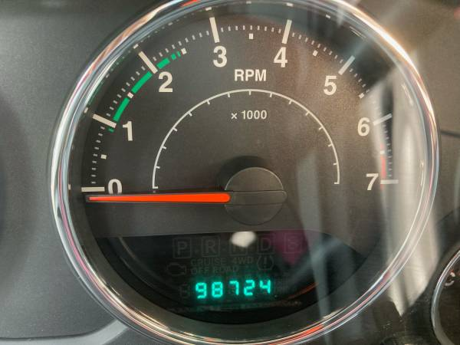
ODOMETER
A good rule of thumb is that your salary should keep up with your odometer.
If your odometer is higher than your pay, you need a raise.
The market value of a software engineer increases by $10-$15k for every year of experience they get.

Slide 41
OTHER

Slide 42
NOTES
Very few companies have a policy of not responding to candidates if they reject.
Candidates can usually re-apply to a company after 6 months to 1 year but even though this is what they say, many companies usually don’t give you another shot if you failed.

